Slide 1
Network team
Jianming Zeng

Slide 2
Cohesive Zone
Cohesive zone model is an model in fracture mechanics in which fracture takes place across an extended crack tip, cohesive zone.

Slide 3
Cohesive Zone Programming
Graph: connected dots
.Input (txt)
FEM → CZM
Efficiency O(1)
Data Structures and Algorithms
Class wiki

Slide 4
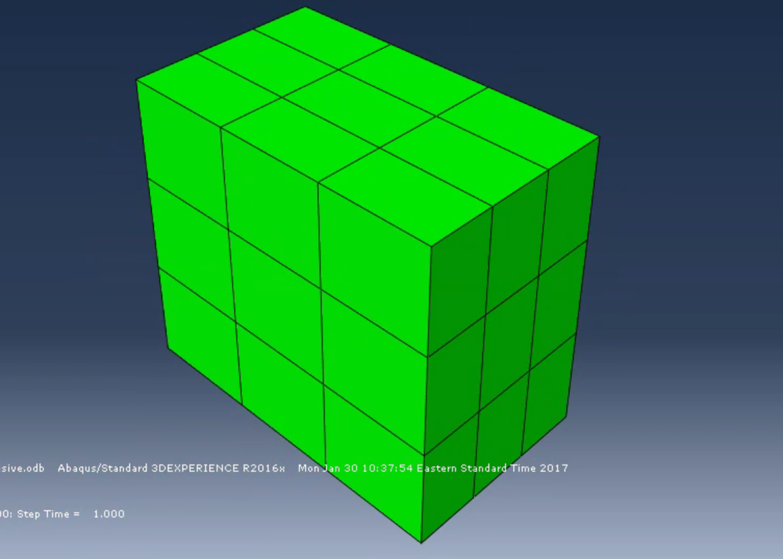
Visual
Goal this semester:
Complete an algorithm for
homogeneous CZM

Slide 5
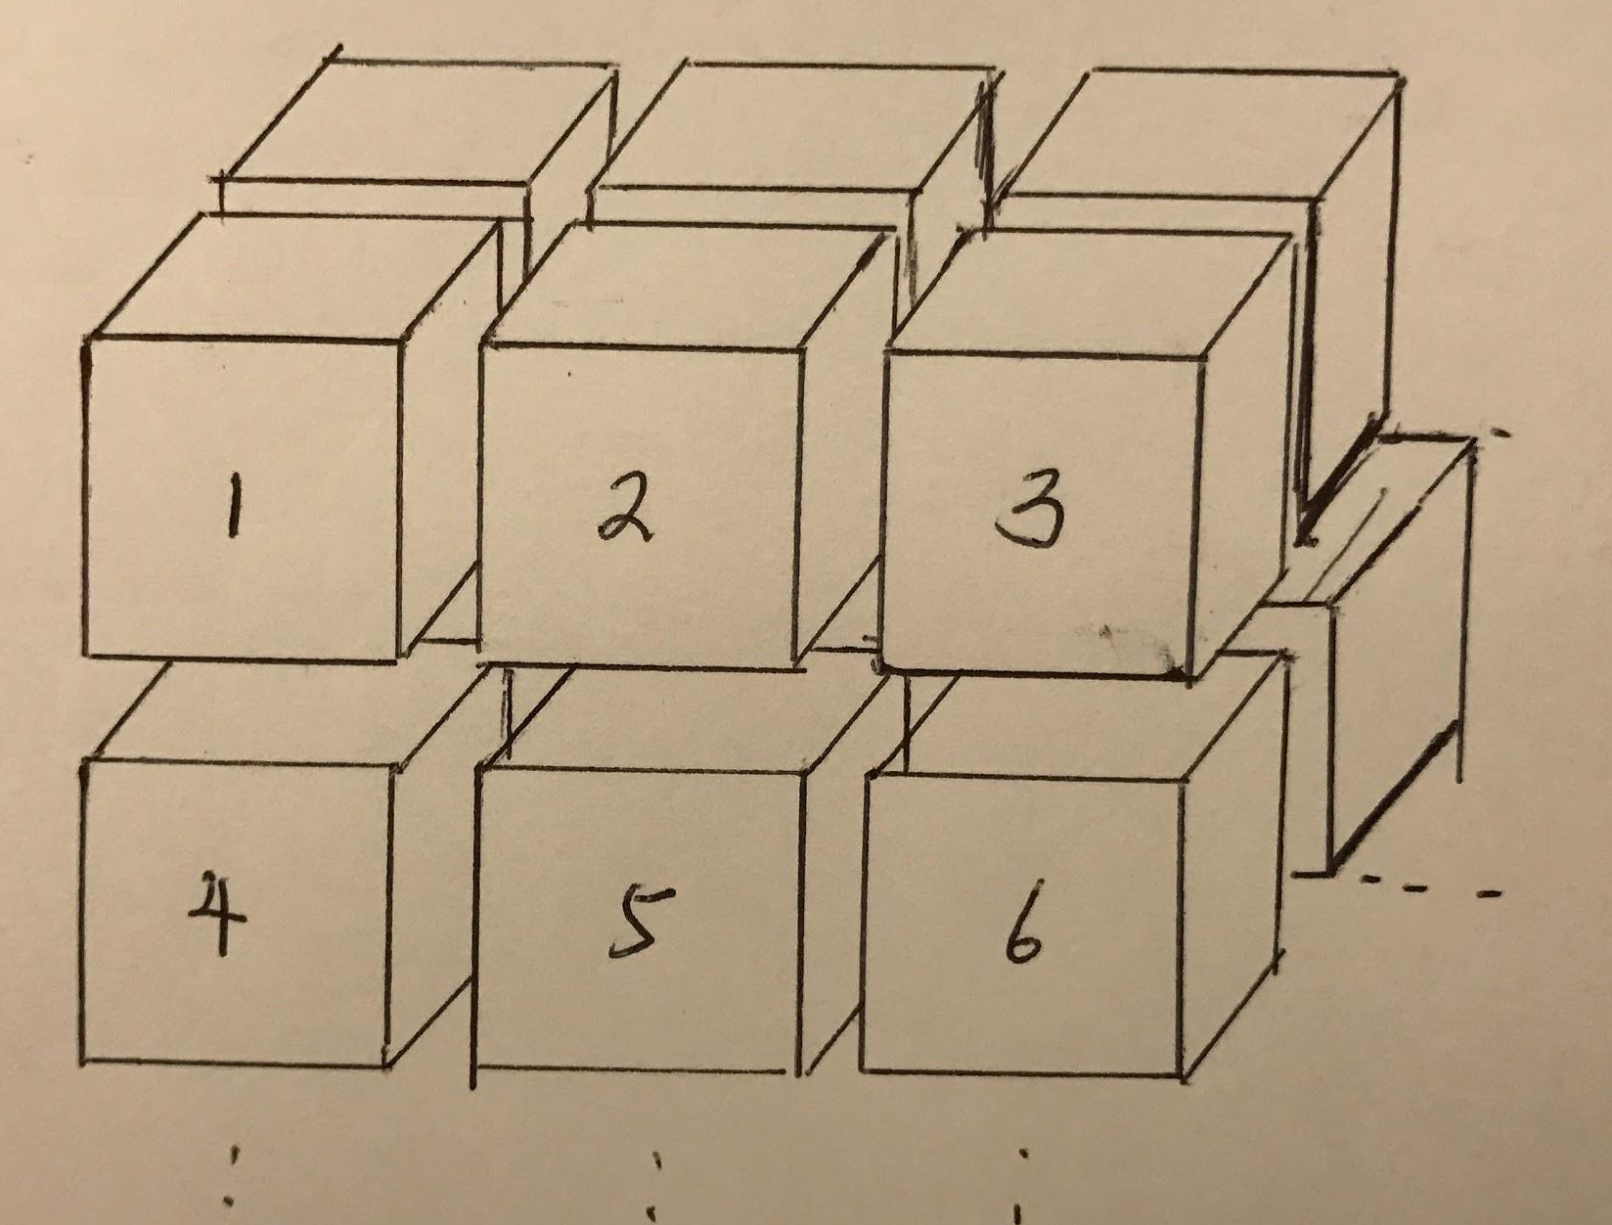
Challenge
3 times more nodes required
Edge → Face
Counterclockwise is enforced in only one direction.

